Slide 1
Parent Information Night
August 13, 2024

Slide 2
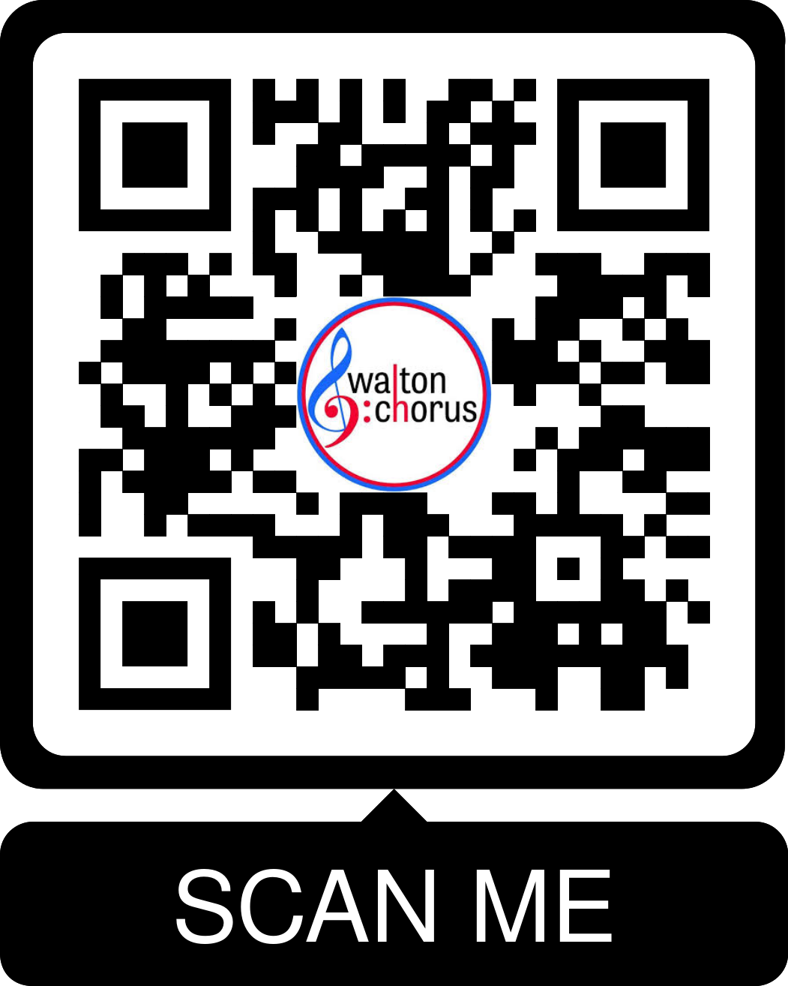
Welcome
Tiffany Whittington
Choral Booster Club President
president.waltonchorusbooster@gmail.com
*Please sign in

Slide 3
Agenda
Welcome and Introductions: Tiffany Whittington
Uniforms: Michelle Dobo and models
Directors: Mr. Wes Stoner & Dr. Alison Mann
Chorus Student President: Carter Henley
Volunteers: Divya Lakshman/Mindy Pekkanen
Boosters: Samantha Ryan

Slide 4
What is the Booster Board?
Who are you as a Booster?

Slide 5
2024-25 Booster Board Members
Divya Lakshman & Mindy Pekkanen:Co-VP Volunteers
Samantha Ryan: VP Booster Relations
Lori Kent: Treasurer
Lisa Crosby: Secretary
Margo Swierenga: Website
Michelle Dobo: Uniforms

Slide 6
2024-25 Booster Board Members
Stephanie Dewitt & Mandy Crawford: Refreshments
Leanne Donnon & Amy Casey: Senior Celebration
Raffle Chair: Margo Swierenga
Lisa Crosby: Dodgen Liaison
Lori Kent: Dickerson Liaison
Members-At-Large:Meredith Gay, Colleen Greblick, Katie Todd, & Kathryn Head

Slide 7
Michelle Dobo (and models!)
Uniforms
michelledobo@gmail.com

Slide 8
August 18
Uniform choice 1 and 2 deadline to pay for uniform (purchased on website www.waltonchorus.com)
September 1
Tuxedo deadline to order uniform with Bel Fiore

Slide 9
What do I have to do?
August 18 (sop./alto) & Sept 1 (tenor/bass)
Uniform deadlines (more information later in the presentation)
michelledobo@gmail.com

Slide 10
Mr. Wes Stoner &
Dr. Alison Mann
Walton Choral Directors
wesley.stoner@cobbk12.org
alison.mann@cobbk12.org

Slide 11
By the numbers…
Men’s Ensemble | 58
Varsity Treble | 73
SWE | 33
A Cappella | 33
Bel Canto | 58
9th Grade Treble Choir | 96
2024-25 Total Singers: | 351

Slide 12
2024-25 Season
What to Expect from HS Chorus
Concert Dates
- October 9, 2024 (6:00pm/7:30pm)
- December 9, 2024 (6:00pm/7:30pm)
- April 21, 2025 (6:00pm/7:30pm)
- Homecoming Game National Anthem - October 18, 2024
- LGPE - March 11-12, 2025 (at Walton)

Slide 13
CutTime
Handbook
Participation Fee
Check info and settings
Varsity Letter - 100 pts. (25 points from fundraising)
Choir Tour/Trips

Slide 14
Carter Henley
Walton Chorus Student President

Slide 15
Divya Lakshman &
Mindy Pekkanen
Chorus Booster Club Co-VPs for Volunteers
volunteers.waltonchorusbooster@gmail.com

Slide 16
Volunteering helps your student earn lettering points!
How?

Slide 17
Volunteer Opportunities
Concert Chaperones
Field trips
Events we host such as LGPE and Homecoming
Other events as needed
Volunteer sign ups will be sent out as we need you!
Please visit www.waltonchorus.com/booster-club/volunteers for more information

Slide 18
Lori Kent
Chorus Booster Board Treasurer
treasurer.waltonchoralbooster@gmail.com
Samantha Ryan
Chorus Booster Board VP Booster Relations
donations.waltonchorusbooster@gmail.com

Slide 19
Booster Club
How much additional cost does it take to operate Walton’s highly successful Chorus Program?
On average each year it costs $100,000 over and above the funding that the county provides.

Slide 20
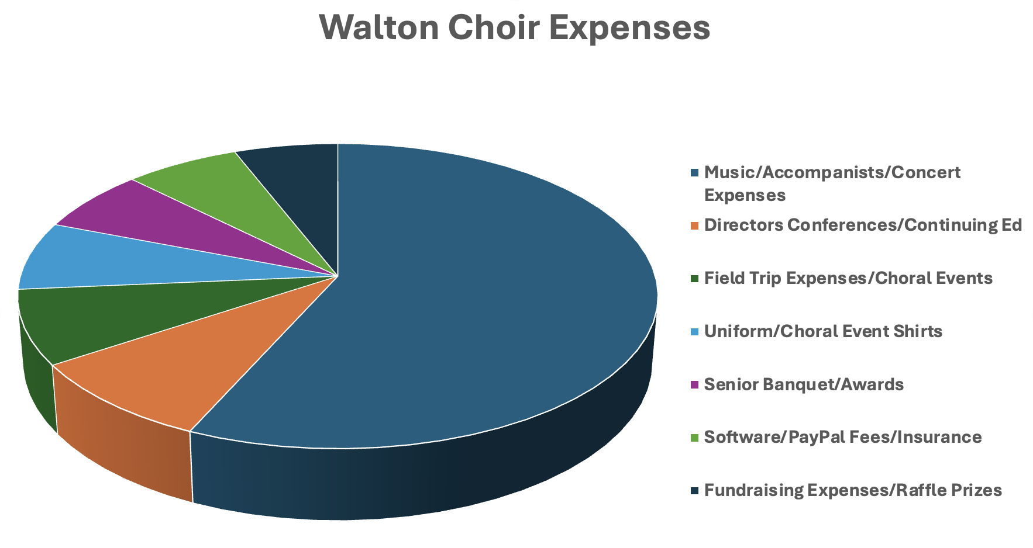
Booster Club
What does Walton Choral Booster Club provide to our students?

Slide 21
Booster Club
How can we, as parents, help?

Slide 22
Fundraising
Pay the required Participation Fee in CutTime
Join Booster Club www.waltonchorus.com (you don’t have to sell anything!)
Request your employer to match your donation
Special Sponsorships
Spring Raffle
Participate in Spirit Nights

Slide 23
What is the Participation Fee?
Paid by all students each year to help cover chorus expenses (including the chorus t-shirt worn at some events)
Payment is made in CutTime
Completely tax deductible
Hardship? Contact Mr. Stoner or Dr. Mann

Slide 24
Booster Donor Levels
and Benefits
Booster Sponsorship Benefits
 | Sponsor | Friend | Patron | Bronze | Silver | Gold | Platinum
 | $50 | $100 | $250 | $500 | 750 | $1000 | $2000
lettering points (each student) | 5 | 15 | 20 | 25 | 30 | 45 | 55
car magnet | ✔ | ✔ | ✔ | ✔ | ✔ | ✔ | ✔
reserved seats at all concerts |  |  | 2 | 3 | 4 | 5 | 6
yard sign |  |  |  |  |  | ✔ | ✔
Reserved parking at concerts |  |  |  |  | 1 | 1 | 2
100% Tax Deductible

Slide 25
Matching Gifts
Coca-Cola
Home Depot
GE, Merck, Assurant
Open Programs
Education or Restricted Programs
Delta, IBM, AT&T

Slide 26
Special Sponsorships
Stage decor
Senior Gifts $1000 (4 available)

Slide 27
2024-2025 FUNDRAISING GOAL
$54,000
approx. $150/family
This helps to pay expenses not covered by Raffle and Event Ticket Sales

Slide 28
PLEASE DONATE
today!
Donating to the booster club is another way your student earns required fundraising letter points

Slide 29
QUESTIONS?
Samantha Ryan
Chorus Booster Board VP Booster Relations
donations.waltonchorusbooster@gmail.com

Slide 30
Don’t Miss a Thing!
Watch for announcements via Cut Time. Become familiar with this program!
Booster communication via Cut Time announcements
Director communication via CTLS
www.waltonchorus.com
Follow us on social media (links at bottom of website homepage)

Slide 31
Your Checklist
Please pay your fees and make a Booster Donation today!
Alert us if you don’t think you are receiving communications from wesley.stoner@cobbk12.org
alison.mann@cobbk12.org
Check the Walton Chorus calendar (at www.waltonchorus.com)

Slide 32
VOLUNTEER!
Opportunities coming soon!

Slide 33
Q & A

Slide 34
Thank You!
Presentation will be posted on the website
under Resources

